Slide 1

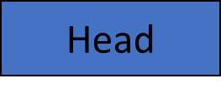
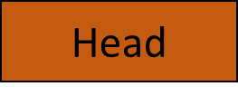
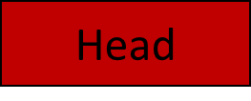
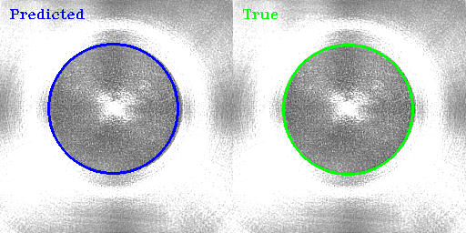
Overall Project View
Data (Azure)
Output
CONV Block
Head
Ensemble
DP
DA
Head
Weighted Average
Data Preprocessing
Data Augmentation
Head
Head
Dense layers with Dropouts

Slide 2
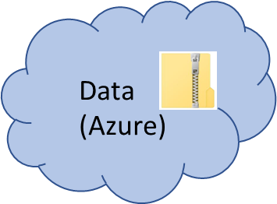

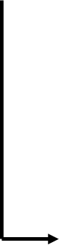
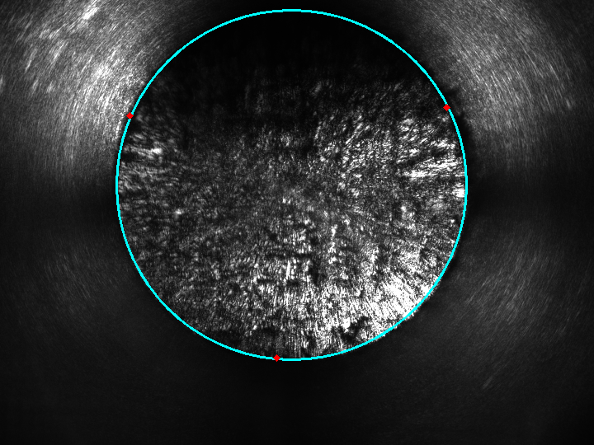
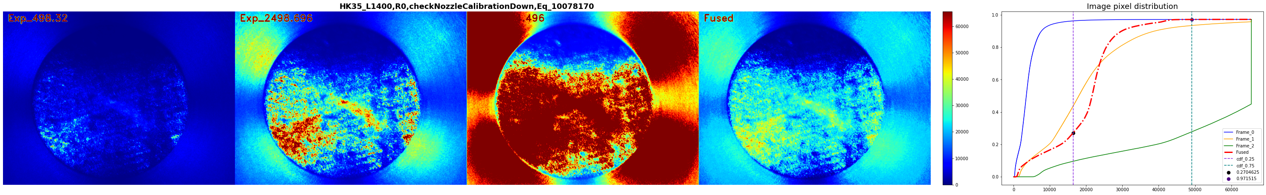
Data Preprocessing
Get images from azure
Exposure Fusion
Label data (Fused Images)
Find radius and center
Final image with label (r,x,y)

Slide 3

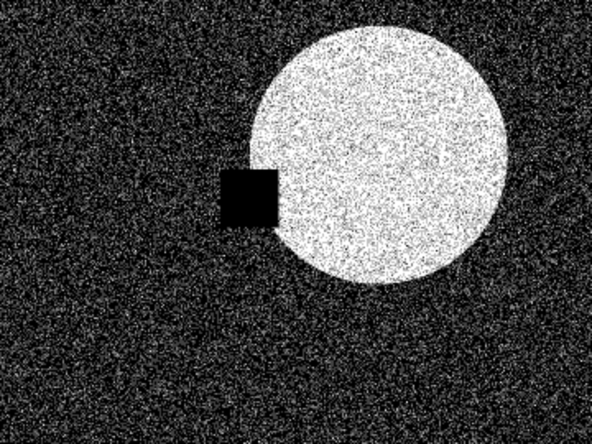
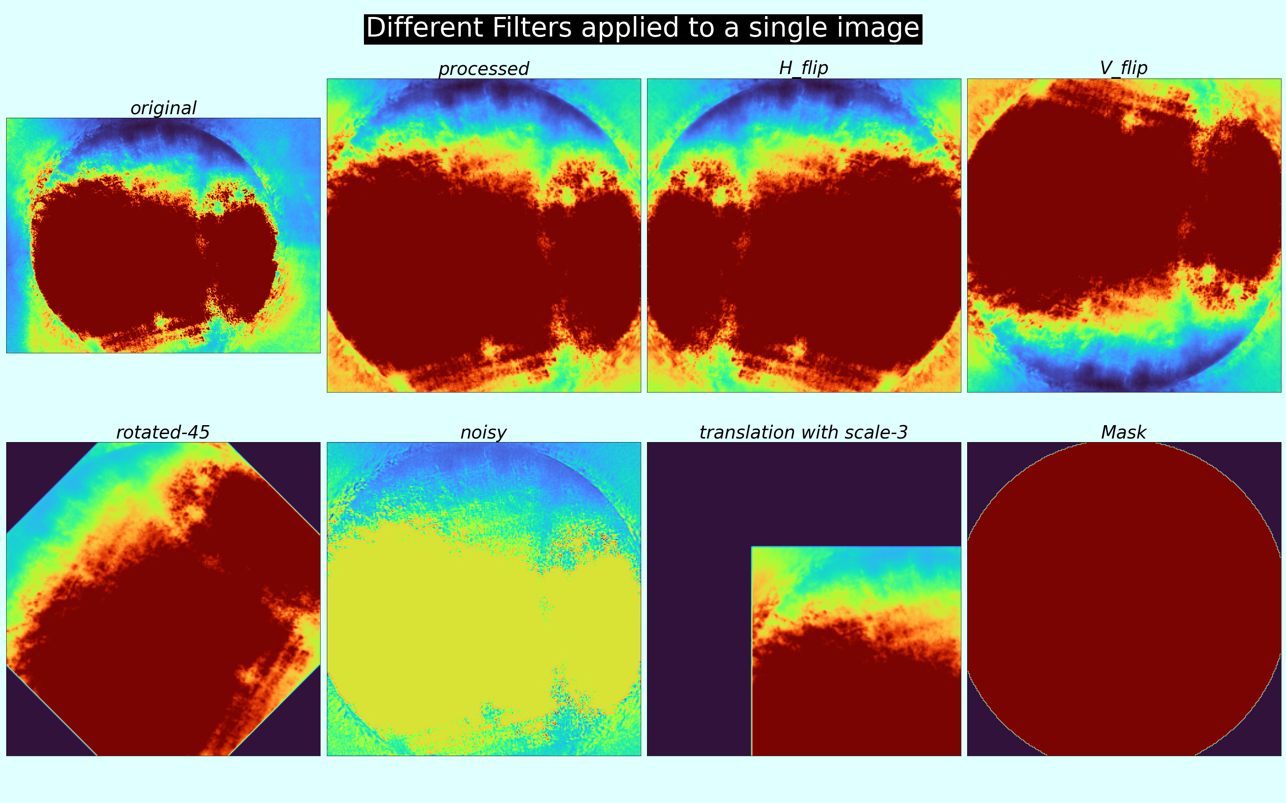
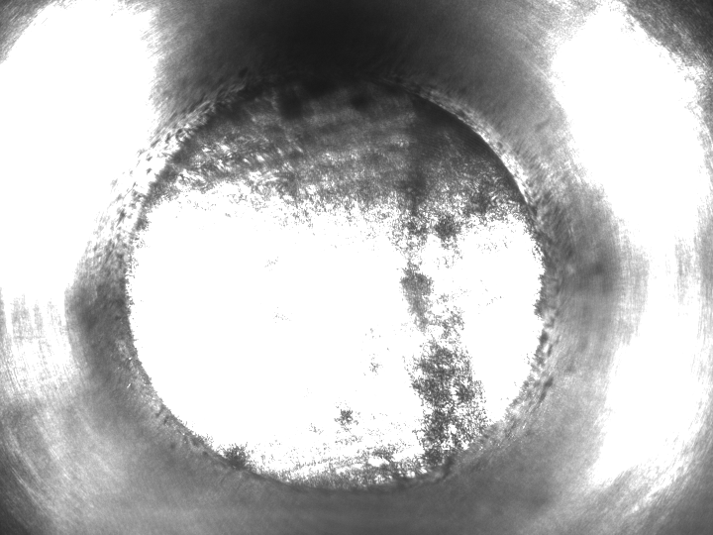
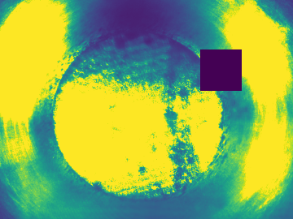
Data Augmentation
Noise : salt & pepper
Random Cut Out
Horizontal and Vertical Flip
Rotation
Random Cut Out
Final Dataset
Zoom and Shift
Randomly select filters

Slide 4
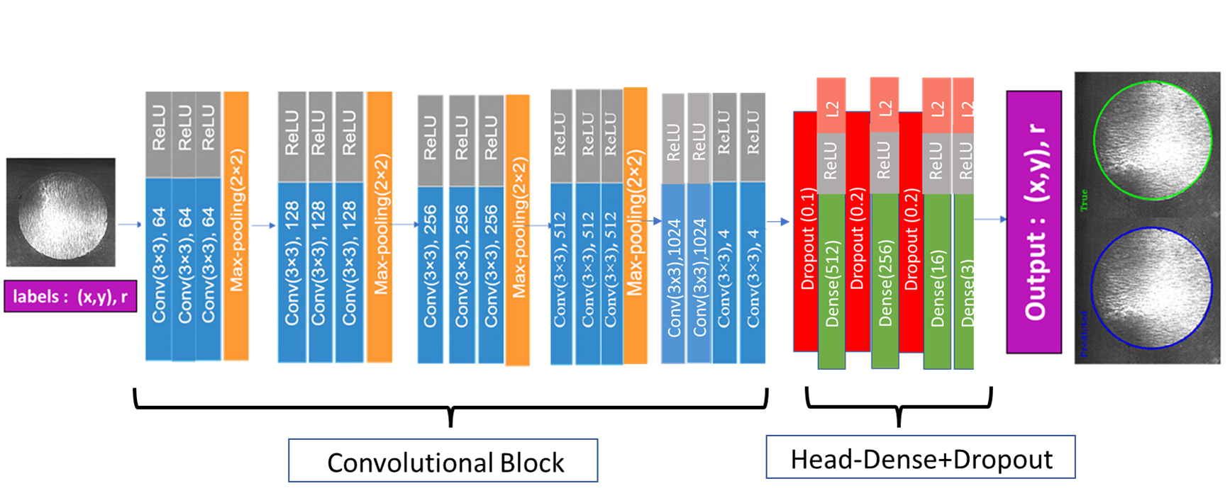
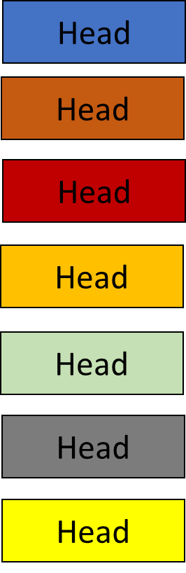
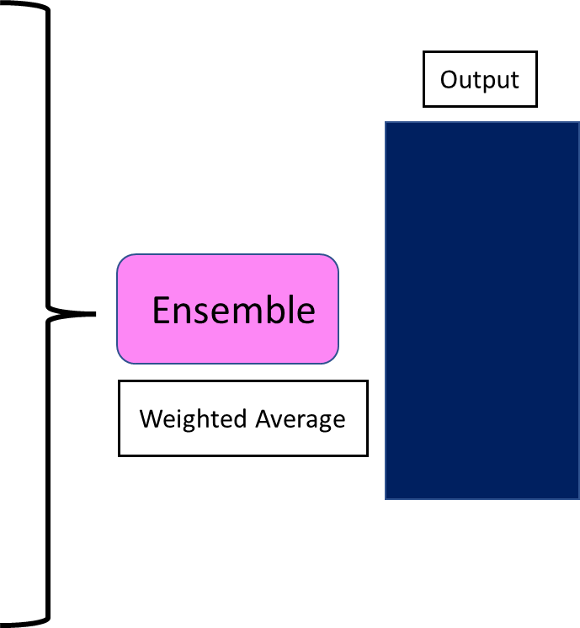
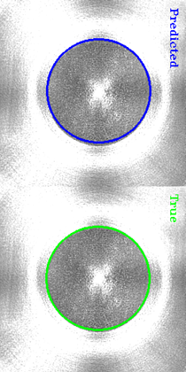
Model-Ensemble Transfer Learning
Freeze Conv B.
Retrain Heads
Save model with each head for the inference

Slide 5
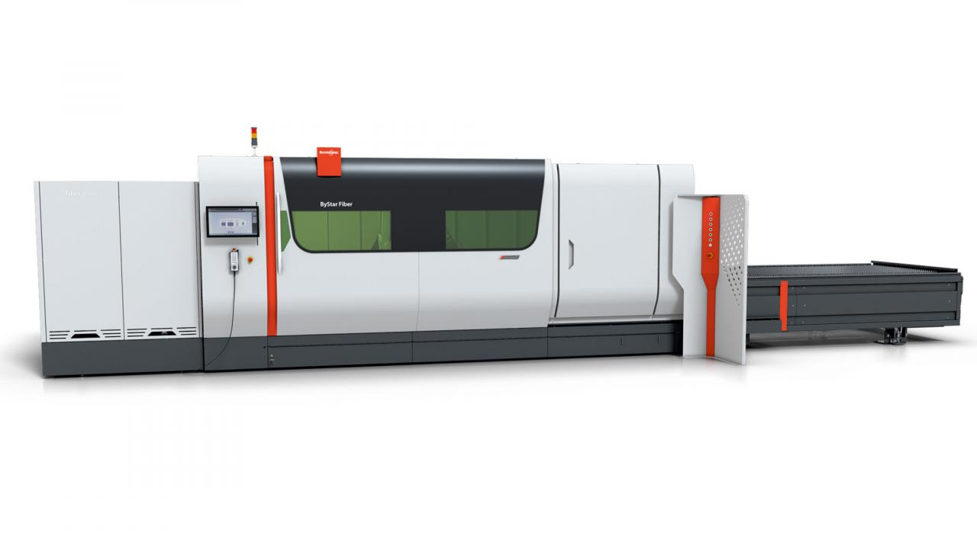
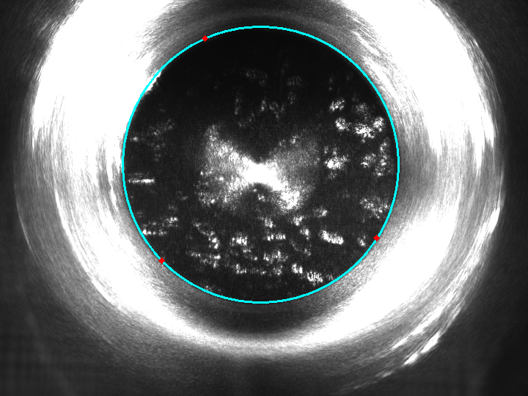
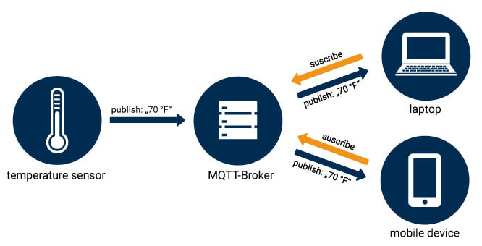
Inference
Data Transfer to edge
(Zip file)
Data Preprocessing
(Resize, fusion)
Load all model with all heads
(ONNX model)
Predict,
Ensemble
MQTT Broker
Final Output

